Slide 1
Note for the diary
Thursdays 10am: coding/investigations club outside my office
Week 3 (Oct 10) there is no class
Week 4 we will be at a BBC/Bellingcat hackday on the Friday Oct 18
Week 6 (Oct 31 and Nov 1) we will have classes instead - although the timetable will probably not show it.

Slide 2
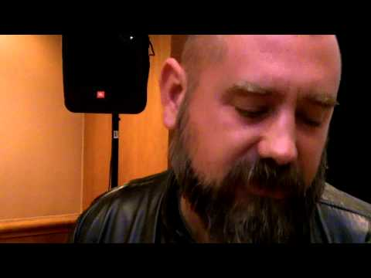

Slide 3
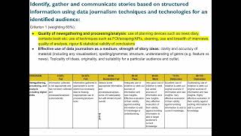

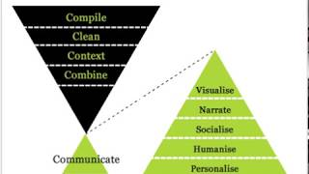
Watch these videos first…

Slide 4
What You’ll Bring
We want passion, drive and a self-starter who can visualise complex ideas in a clear, accurate, creative, and intelligent manner.
A good understanding of statistics and statistical analysis.
A good understanding of how to visualise data, perhaps using tools like Flourish, Datawrapper, QGIS or d3.
Proficiency at writing detailed and accessible articles presenting data analysis.
Strong journalistic judgment and editorial values.
Understanding of Excel and Google Sheets is essential.
A knowledge of programming language for data analysis, such as R, Python or SQL is preferred.
Knowledge of web development programming languages like HTML/CSS and JavaScript is an advantage.
Sky News Data Journalist job ad

Slide 5
What You’ll Do
Find, clean and analyse data to produce stories for Sky’s digital and broadcast platforms.
Examine and report on published data to provide context, analysis and news lines on the biggest stories of the day or identify new stories.
Pitch, develop and deliver original data-driven investigations and come up with ideas as to how they might be presented.
Work either independently or alongside designers and developers to create compelling visualisations and interactives.
Negotiate with public officials, businesses and academics for data and open records and gather information via Freedom of Information requests.
Lead the way in explaining data journalism to our audiences.
Sky News Data Journalist job ad

Slide 6


Journalism + Data
@PaulBradshaw
#bcujournos

Slide 7

Journalism + Data
@PaulBradshaw
#bcujournos

Slide 8
What we’ll cover:
How to generate news ideas vs features — and pitch those
How to incorporate data into your reporting
Identifying problems in our processes: news values, and routine sources

Slide 9
What is
journalism (for)?

Slide 11
Kovach & Rosenstiel’s Elements of Journalism (1-5)
Journalism’s first obligation is to the truth
Its first loyalty is to citizens
Its essence is a discipline of verification
Its practitioners must maintain an independence from those they cover
It must serve as an independent monitor of power

Slide 12
Kovach & Rosenstiel’s Elements of Journalism (6-10)
It must provide a forum for public criticism and compromise
It must strive to keep the significant interesting and relevant
It must keep the news comprehensive and proportional
Its practitioners must be allowed to exercise their personal conscience
Citizens, too, have rights and responsibilities when it comes to the news

Slide 13
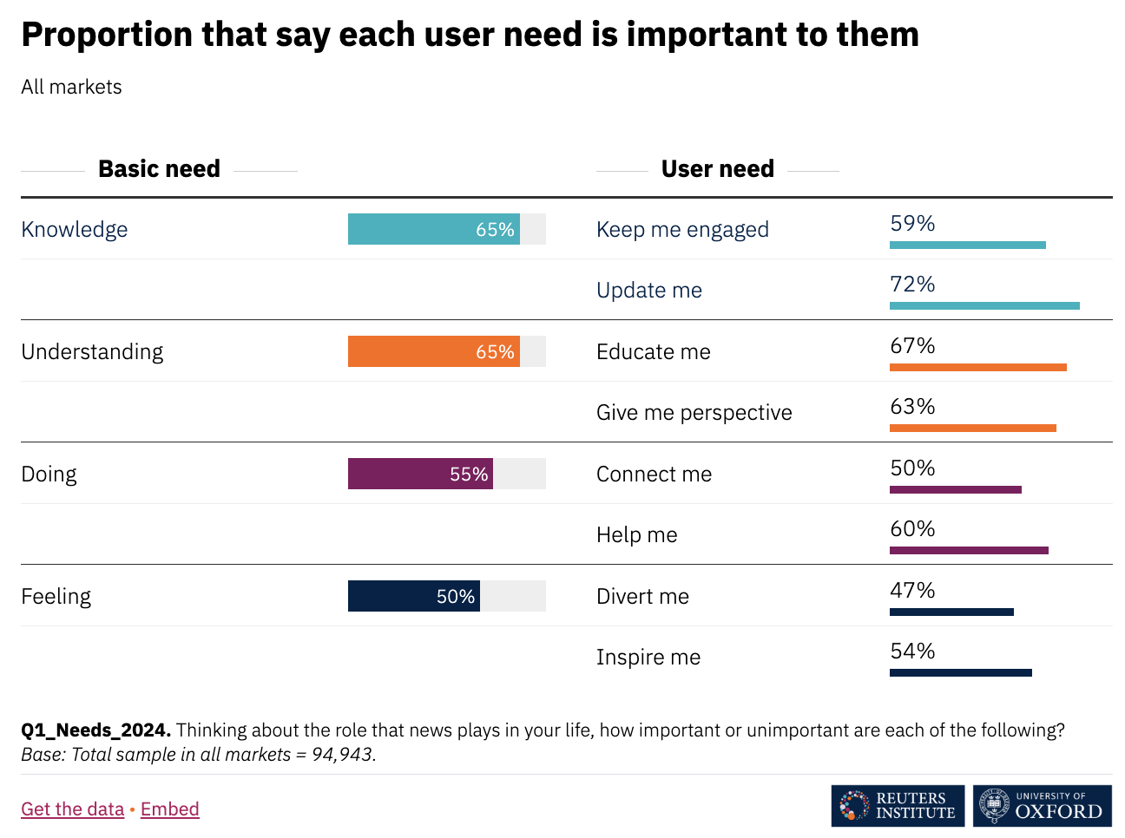
Fletcher (2024)

Slide 14
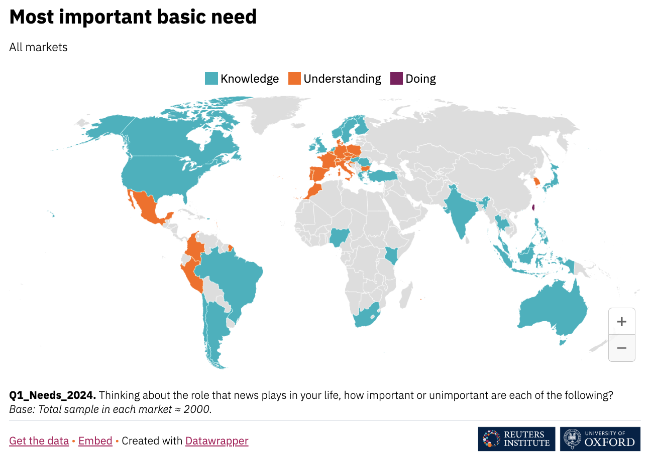
Fletcher (2024)

Slide 15
How do we meet those needs?
News stories: ‘update me’, ‘connect me’
Features:
‘divert me/inspire me’ (interview features),
‘educate me/give me perspective’ (multi-interview features, investigations, profiles, explainers),
‘help me’ (how-tos, tips and tutorials),
‘keep me engaged’ (e.g. charticles)

Slide 16
What do we mean by
news stories and features?

Slide 17
What do we mean by
news stories and features?
News stories are based on new information (or new to your audience).
News is short and normally done quickly

Slide 18
What do we mean by
news stories and features?
News stories are based on new information (or new to your audience).
News is short and normally done quickly
Features often take a news report as a starting point for deeper exploration — or are timeless (“evergreen”)
Multiple genres: explainer? Interview feature? Charticle? Investigation?
Features are longer, and often take more time

Slide 19
Quiz: news or feature?
Edwards given suspended jail term for abuse images
Four key takeaways from Huw Edwards' sentencing
Navigating life after divorce
Shailendra: Music glory of a legendary lyricist
Annabel Sowemimo shortlisted for British Academy Book Prize 2024
Diane Abbott: Starmer treated me as a 'non-person'
‘I don’t do a monthly shop any more’: life with unpredictable working hours
Secret Service MONITORS Musk post
Here’s what we know on Donald Trump’s assassination attempt

Slide 20
Identifying a potential news story
Typically what people/orgs/data/docs do, say or reveal
Event (crime, accident, launch, arrest, resignation, etc.)
Lead up to event (details revealed, “to be held”)
Action (“announces”, “to investigate”, “decide”, “vote”)
Concerns/complaints “raised”, accusation made
Reaction (“defends”, “denies”, “admits”, “rejects”, “welcomes”)
Money being cut/invested/spent/raised
Research/report/data “reveals”/“finds”
Conflict/resolution (“refusing to”, “in row over”, “in talks over”)
‘Follow-on’ (local dimension to/version of a national story)

Slide 21
Identifying a potential news story
Typically what people/orgs/data/docs do, say or reveal
Event (crime, accident, launch, arrest, resignation, etc.)
Lead up to event (details revealed, “to be held”)
Action (“announces”, “to investigate”, “decide”, “vote”)
Concerns/complaints “raised”, accusation made
Reaction (“defends”, “denies”, “admits”, “rejects”, “welcomes”)
Money being cut/invested/spent/raised
Research/report/data “reveals”/“finds”
Conflict/resolution (“refusing to”, “in row over”, “in talks over”)
‘Follow-on’ (local dimension to/version of a national story)

Slide 22
Where do I find out about all these?
News diaries (events) - forward planning
Checking in with orgs regularly involved (police, fire, local and national government, courts, charities/campaigners)
Monitoring likely newsworthy pages, e.g. fundraising websites, accounts of newsworthy figures/orgs
Subscription to newswires, Dataminr, press releases, alerts on publication of new research, reports and data
Doing interviews and identifying a newsworthy lead
Seeking reaction and follow-ups on stories in the news elsewhere

Slide 23
What potential problems are there?
If these are our routines for sourcing, how might that shape which stories that are told, who tells them, and how?
News diaries (events)
Checking in with orgs
Monitoring likely newsworthy pages and accounts
Subscriptions and updates
Interviews
Reaction and follow-ups on current stories

Slide 24
How do journalists/editors choose which story to pursue?
News values identified by Galtung and Ruge (1965)
Impact, audience, and practicality
Bad news (with context); good news
Power elite (factchecking, accountability)
Agenda
Magnitude (scale of problem)

Slide 25
What’s in the news right now?
(the news agenda)

Slide 26
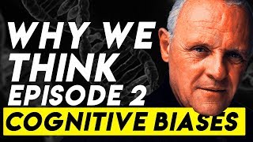
Availability cascades
An event puts an issue in the news (availability bias)
That leads to more stories on the issue (bandwagon effect)
Availability entrepreneurs get involved, & call for action
Which leads to action, even if it’s ineffective/out of proportion
Examples: stop the boats;
injection spiking
See also: moral panics

Slide 27
News values evolve.
Harcup & O’Neill (2001) added:
Surprise, celebrity, entertainment
Drama and conflict
Exclusivity
Arresting audio-visuals, shareability
Relevance (to identified audience)
Follow-up (to events)

Slide 28
TIP: Use these concepts to aid your own idea generation and development. Reflect on them in your evaluation.

Slide 29
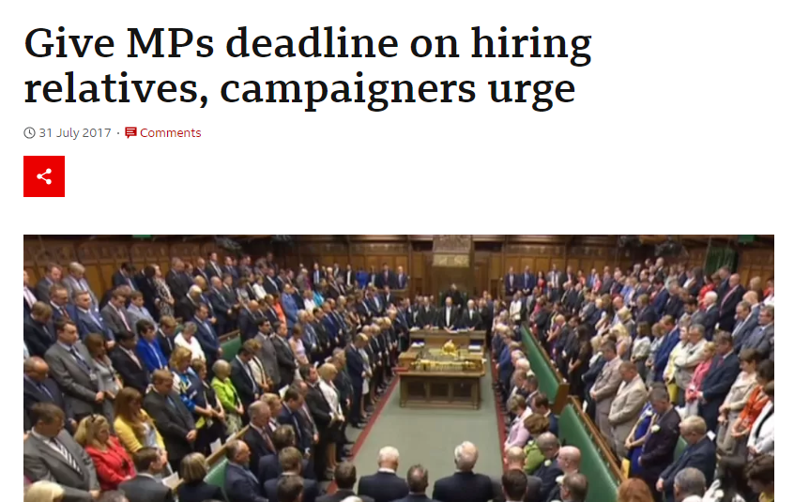
An example.
If I evaluated this story I worked on:
Data showed that one in five MPs employed a relative (a scale story according to Bradshaw (2022)). This met Galtung and Ruge’s (1965) news values of stories involving the power elite, and ‘bad news’ — but interviewing campaigners added the news value of conflict (Harcup and O’Neill 2001) and the team decided to lead on that aspect of the story.

Slide 30
Key points so far:
Journalism serves a range of purposes, and takes a variety of forms
News is short and simple; features are longer and more varied
Stories are chosen based on news values and journalists rely on routine sources, both of which are problematic

Slide 32
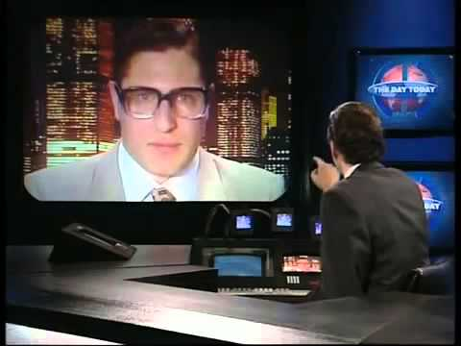

Slide 33
Journalism + Data
@PaulBradshaw
#bcujournos

Slide 34
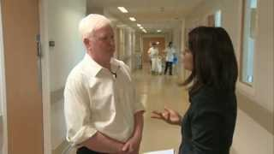
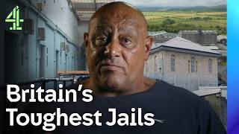

Bringing data into journalism
Data can be the story (new data ‘reveals’; data-driven explainer; interactive formats)
It can flesh out the story (context to news/feature)
Data can lead you to the story (e.g. interview)

Slide 35
Example: pupil behaviour
News story: ‘Bubble’ of post-pandemic bad behaviour among pupils predicted to peak (Interview-led: “Experts say ‘desocialised’ pupils home schooled through Covid are entering traditionally most disruptive years”, + data context)
Follow-up news story: Fifty English secondary schools suspended more than a quarter of pupils after pandemic (Data is the story: the scale of a problem ‘revealed’)
Follow-up feature: ‘It’s about developing relationships with pupils’: the school working to reduce suspensions (data leads to org: look at one possible solution + data context)

Slide 36
Examples: ‘follow-up’ stories
News story: energy cap announced by Government.
Data follow-up (feature): How Much Will It Cost to Run Appliances Under the UK Energy Cap?
News story: Queen to celebrate 70th year of reign.
Data follow-up features (planned): The Queen's 70-year reign in 10 charts (also The Times and Al Jazeera)
News stories about flags being flown and used in Zoom calls.
Data follow-up news stories: UK government spends more than £163,000 on union flags in two years; Ministry of Defence spending on flags more than doubles

Slide 37
Bringing data into journalism: news vs features
News: New data ‘reveals’; exclusive analysis ‘reveals’
Features: Mapped; Interactive; Analysis; Explainer; ‘in numbers/charts’
Data is the story
News: event- or interview-led story includes key figures/charts
Features: interview/analysis/investigation includes key figures/charts
Data fleshes out the story
Data identifies best/worst/typical places/orgs/people to visit/interview
Data identifies a trend to explore
Data provokes action/reaction
Data leads to the story

Slide 38
In terms of story sources…
Events diaries: what events might lend themselves to data?
Subscribe to updates on publication of new research, reports and data
Use data to identify potentially newsworthy interviewees
Use data to inform interview questions and add context to story
Seek data to follow-up on stories in the news elsewhere
Set the news agenda with an exclusive analysis that reveals something
Use data analysis to prompt a reaction (e.g. calling for action, taking action, reviewing policy)
Use data to provide a different perspective on a story (i.e. interactivity, personalisation, calculators, simulators, etc.)

Slide 39
Easier:
DATA
IDEA
STORY

Slide 40
Easier:
Harder:
DATA
IDEA
IDEA
DATA
STORY
STORY

Slide 41
Your turn: RADAR’s interview task
The following is a brief given to shortlisted applicants for a data journalism role at the Press Association’s “automated news agency” RADAR. Please follow the below instructions and share your answers on the MED7373 channel on Slack.

Slide 42
At RADAR, we write stories for local and regional papers, based on datasets, using natural language generation software to produce multiple versions.
You have a dataset on knife crime from 2013 to 2023.
Pick out any interesting trends the data shows.
Decide what story angles you would take if you were writing this story for RADAR.
Remember, we don’t write stories individually for each area, so we group places which have similar trends and use software to produce the different versions.
Think about who you would like to approach for comment.

Slide 43
Table 4: Knife and offensive weapon offences resulting in a caution or sentence by police force area, in England and Wales, annually from year ending December 2013
Police Force Area | Number of offences, year ending December
 | 2013 | 2014 | 2015 | 2016 | 2017 | 2018 | 2019 | 2020 | 2021 | 2022 | 2023
England and Wales | 16,259 | 16,312 | 17,475 | 19,304 | 21,153 | 21,668 | 22,472 | 18,544 | 19,713 | 19,376 | 18,813
Avon and Somerset | 423 | 369 | 408 | 428 | 472 | 484 | 500 | 435 | 434 | 378 | 452
Bedfordshire | 182 | 198 | 214 | 236 | 317 | 244 | 222 | 156 | 193 | 178 | 208
Cambridgeshire | 183 | 179 | 206 | 251 | 231 | 246 | 260 | 213 | 228 | 271 | 273
Cheshire | 247 | 236 | 261 | 303 | 380 | 429 | 365 | 320 | 244 | 251 | 293
City of London | 17 | 17 | 22 | 15 | 41 | 25 | 33 | 30 | 25 | 24 | 35
Cleveland | 272 | 257 | 255 | 261 | 276 | 278 | 353 | 322 | 338 | 371 | 356
Cumbria | 141 | 134 | 146 | 141 | 163 | 151 | 162 | 144 | 142 | 128 | 155
Derbyshire | 228 | 280 | 305 | 335 | 285 | 351 | 353 | 323 | 381 | 343 | 287
Devon & Cornwall | 301 | 337 | 320 | 341 | 405 | 375 | 426 | 436 | 377 | 379 | 337
Dorset | 149 | 144 | 161 | 207 | 221 | 203 | 254 | 204 | 187 | 208 | 203
Durham | 240 | 236 | 234 | 182 | 185 | 202 | 182 | 178 | 175 | 181 | 165
Dyfed-Powys | 128 | 114 | 94 | 128 | 98 | 140 | 162 | 119 | 106 | 103 | 95
Essex | 472 | 465 | 411 | 479 | 556 | 528 | 622 | 493 | 532 | 525 | 483
Gloucestershire | 113 | 116 | 132 | 118 | 161 | 118 | 161 | 108 | 123 | 129 | 117
Greater Manchester | 828 | 773 | 775 | 772 | 917 | 1,026 | 1,189 | 897 | 945 | 1,085 | 1,132

Slide 45
RADAR’s interview task
Now review each other’s ideas:
Which are the strongest ideas — why?
What suggestions do you have for improving the idea?
What suggestions do you have for improving the way it is communicated? (The ‘pitch’)

Slide 46
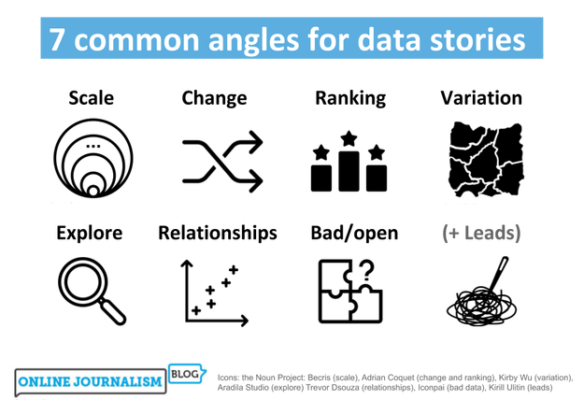
https://onlinejournalismblog.com/2020/08/11/here-are-the-7-types-of-stories-most-often-found-in-data/

Slide 47
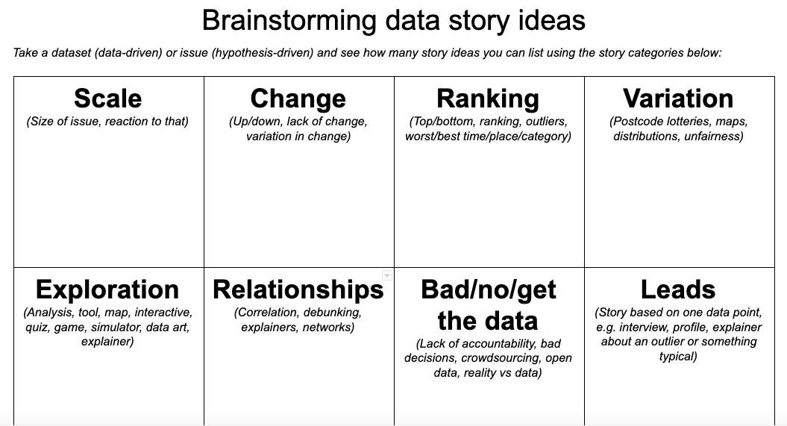
https://docs.google.com/document/d/1QSX7IN2oOzGFsrwF-mL_04F5ANyvkHWixfrOZPa7xsg/edit?usp=sharing

Slide 48
“In most cases data journalists are not involved in designing experiments and proving or confirming hypotheses, rather they are exploring the data to find stories that are interesting, relevant, important and/or informing to their audiences. We can say data storytellers are often concerned with exploratory data analysis in their work, as opposed to confirmatory data analysis [confirming a hypothesis].”
Bahareh Heravi, forthcoming

Slide 49
A critical response to that
Is it really entirely exploratory?
When we look at data we often have a hunch or preconception of what we are expecting to find (e.g. things are getting worse).
Think about how your own practice confirms or challenges what Heravi says — and what that means (e.g. potential confirmation bias).

Slide 50
Data tells you what has happened.
Your reporting needs to attempt to establish why it is important
and why it might be happening.

Slide 51
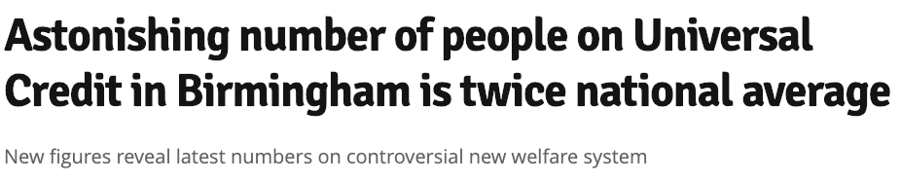
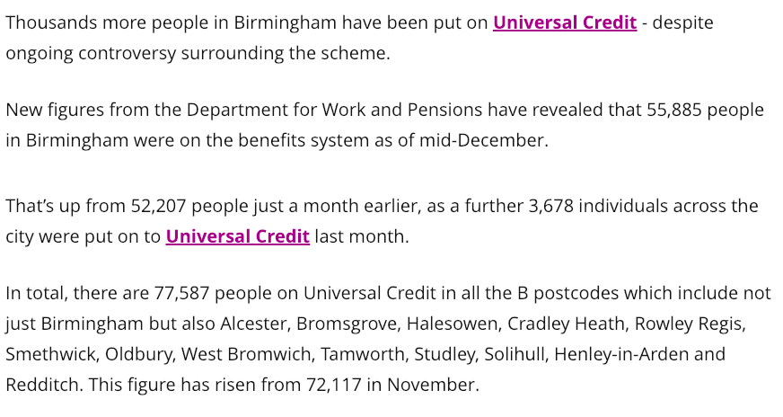
🤷
https://www.birminghammail.co.uk/news/midlands-news/astonishing-number-people-universal-credit-15723714

Slide 52
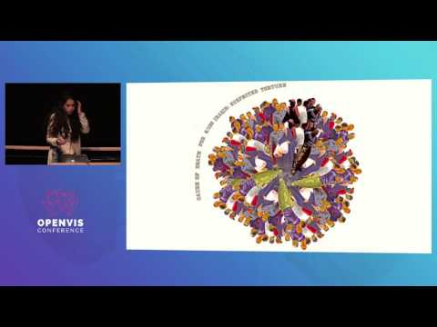
Mona Chalabi: “The ability for people to get in touch and explain to me the ‘why’ is super important - I’m not saying I’m going to accept those anecdotes at face value but it gives me new lines of enquiry”

Slide 53
Tip: reference that video!
Make notes at the time so you can explain how the video informed your work, then explain in the evaluation, with (Chalabi 2016) and in the bibliography:
Chalabi, Mona (2016) Informing without Alienating. [video] OpenVis Conf, April 25th-26th, 2016. Available at: https://www.youtube.com/watch?v=5C8AvYVt4_0 [Accessed 21 September 2023].
Harvard - audio, visual and multimedia - Library & Learning Resources | Birmingham City University (bcu.ac.uk)

Slide 54
Other story ideas
RADAR was asking for stories where the data is the story.
Taking one of those story ideas, imagine it’s already been reported and come up with ideas for ‘follow ups’:
How might the data lead you to a story?
What features might follow up on what was revealed?
Who could you interview that might give you a new story — and what data would be needed to add context?

Slide 55
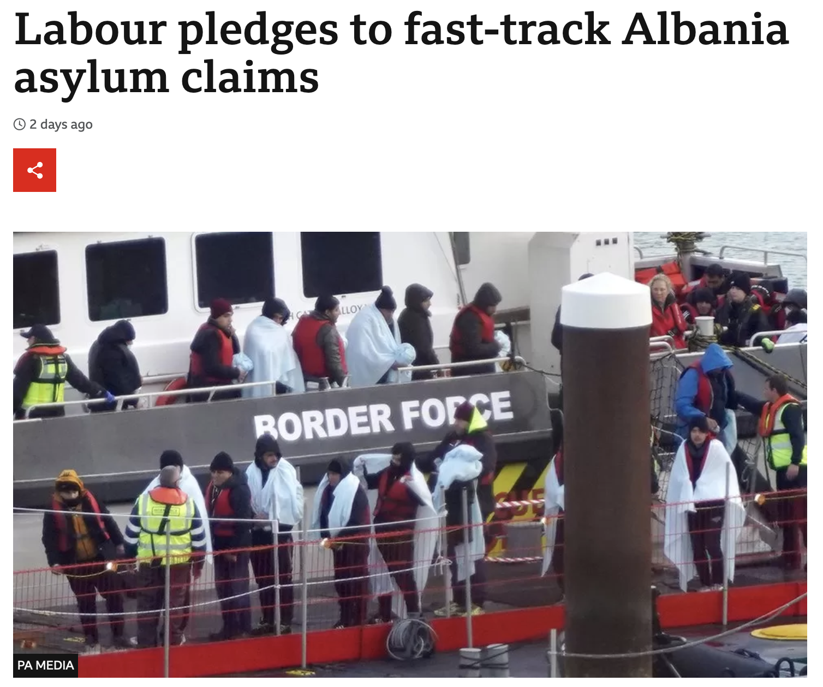
Follow up:
An explainer story could look at how many claims this would affect, and which countries are involved. Search for 'designated safe countries asylum' to find the countries. Then look at asylum and resettlement datasets and classify the countries accordingly to work out the totals.
https://www.bbc.co.uk/news/uk-politics-63908240

Slide 56
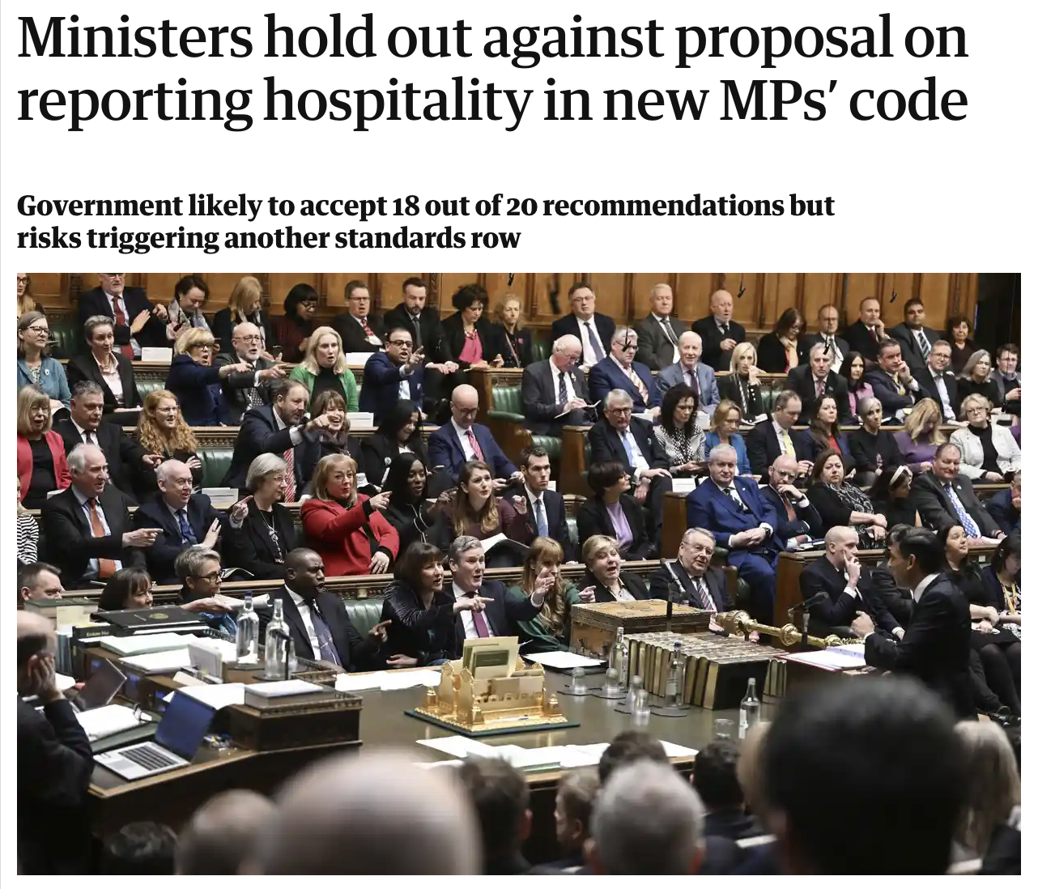
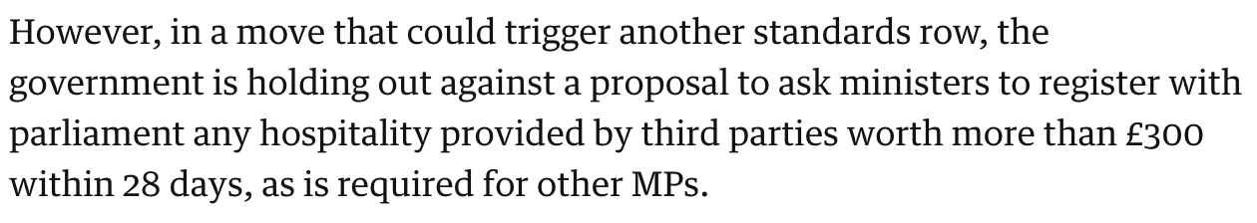
Follow up:
A good excuse to look at the Register of Members' Financial Interests (what MPs have to register) and/or the hospitality data for ministers (what ministers have to register). Something like 'What hospitality has your MP received' or '5 things we know about ministers' hospitality — and what we don't know' would give you a good format to work within
https://www.theguardian.com/politics/2022/dec/10/ministers-hold-out-against-proposal-on-reporting-hospitality-in-new-mps-code

Slide 57
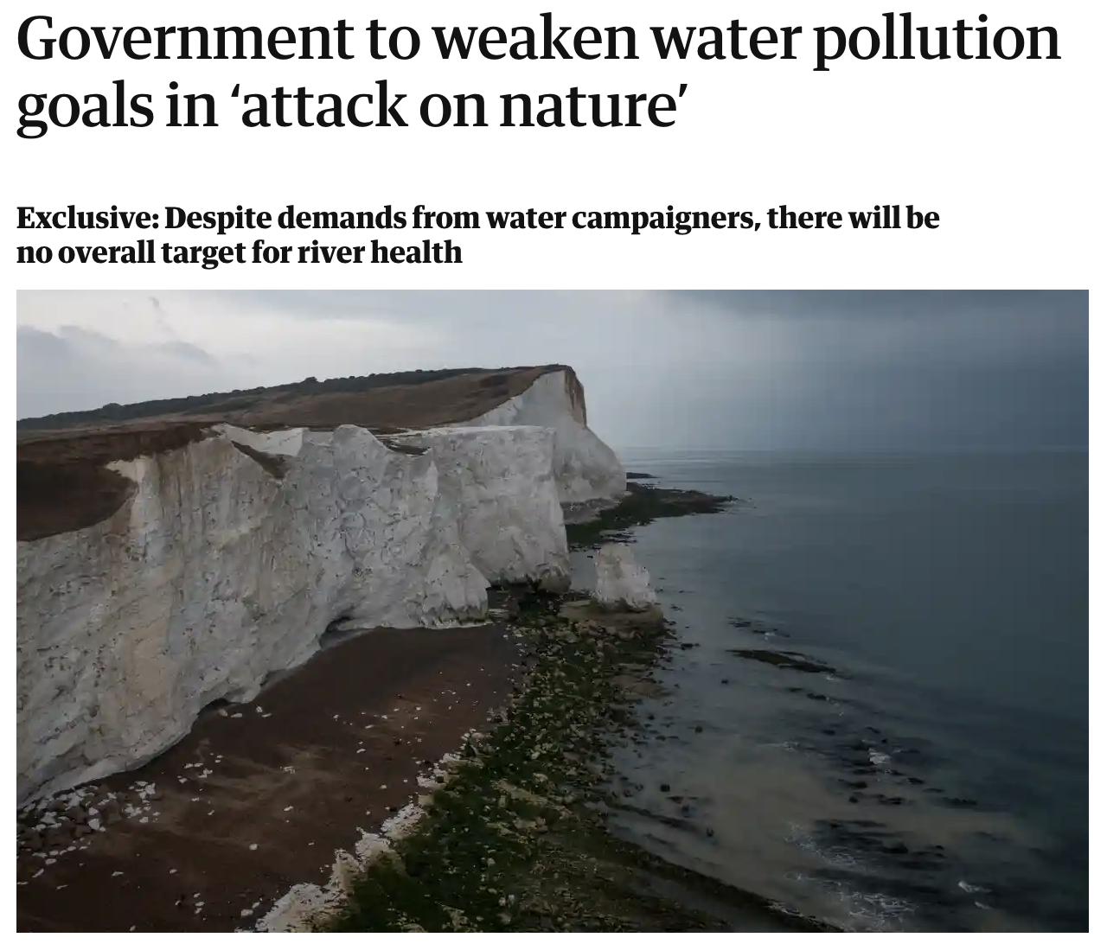
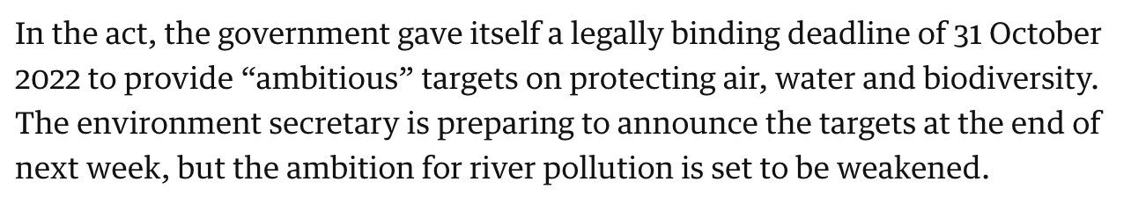
Follow up:
A good reason to look at water pollution data and how it's changed (or not) or which places are missing the current targets
https://www.theguardian.com/environment/2022/dec/09/government-to-weaken-water-pollution-goals-river-health

Slide 58
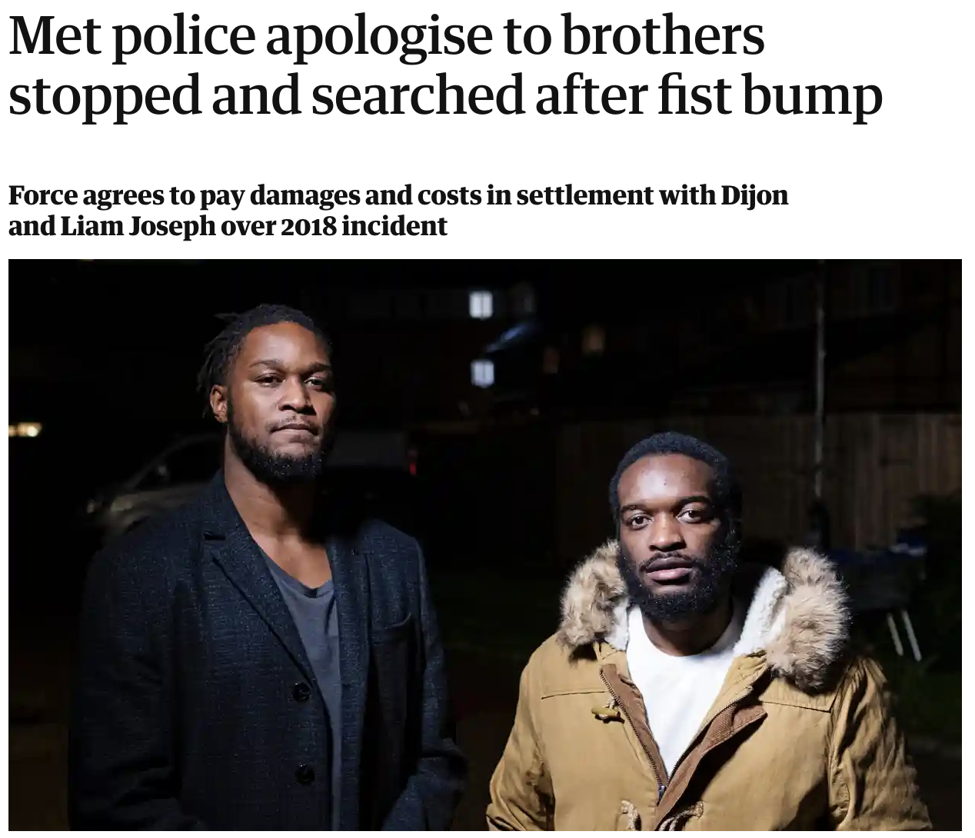
Follow up:
A strong topical hook for a backgrounder feature on how many black people are/were stopped and searched by the Met Police - or any police force for a local audience
https://www.theguardian.com/uk-news/2022/dec/09/met-police-apologise-to-brothers-stopped-and-searched-after-fist-bump

Slide 59
Pitching the ‘top line’
What is the action in the story?
Data/report/doc/analysis reveals something
Someone or something has said something (criticises, calls for, urges, reveals, says, announces, warns, blames, accuses)
Someone or something has done something (launches, cancels, rescues, quits, attacks)

Slide 60
A feature ‘hook’ sells
What is the reason for and purpose of the story?
A particular news event raises questions - in a special feature, we [try to] answer those
This person is newsworthy because of these reasons - in this feature she tells us X, Y and Z
A particular problem is faced - in this feature we explore how to solve it
Something that happened is surprising - in this feature we explain what happened

Slide 61
Justifying it (news/feature)
Why is this story worth reporting (now)?
“It’s very topical”/the ‘news hook’: this issue is already in the news (or will be) and our story will add something new
“It’s an exclusive”: no one else has your access/ quotes/data/analysis
“No one else is covering this”: you’ll have to answer “Why is no one else covering it?”
A mission: organisational objectives, e.g. hard-to-reach audiences

Slide 62
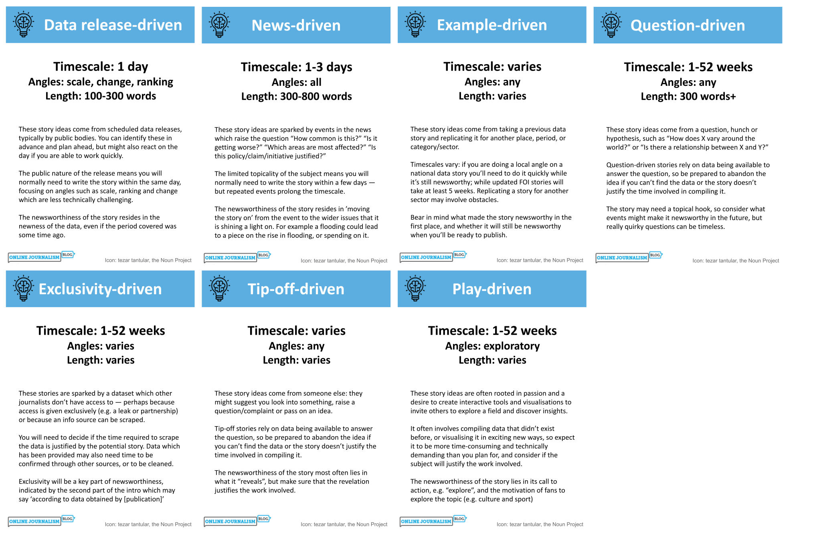
Other workflows:
https://datajournalism.com/read/longreads/data-journalism-ideas

Slide 63
Key points:
Keep it simple - and focused: who/what is saying/doing what (the top line)
Answer the ‘why’ question: get quotes (but publish without if it’s taking too long)
Use literature to provide a critical framework: news values; 7 angles; etc.

Slide 64
“Data can be the source of data journalism, or it can be the tool with which the story is told — or it can be both. Like
any source, it should be treated with scepticism; and like any tool, we should be conscious of how it can shape and
restrict the stories that are created with it.”
Paul Bradshaw, Data Journalism Handbook 1

Slide 65
Test your knowledge!
https://moodle.bcu.ac.uk/mod/quiz/view.php?id=8628069

Slide 66
On Moodle: the learning journal
Spend 5 mins documenting what you’ve learned this week.

Slide 67
Reading (1-2 hours):
D’Ignazio & Klein (2020) Data Feminism: ch4 “What Gets Counted Counts”
Prepare for next week by reading the Data Journalism Heist (link to free copy)

Slide 68
Directed study (5-7 hrs):
Review examples of data journalism - what sources do they use? Where has the idea come from? What angle? Make notes. (30-60’)
Create a news diary (e.g. in Google Calendar)
Look for data sources and brainstorm ideas. Share your story ideas on Slack and give feedback to others. (30-60’)
Use the techniques from the Data Journalism Heist to analyse data. Have problems/questions to bring to the next class

Slide 69
And: WhoFundsThem
"With your help, we’ll answer a set of important questions for all MPs, then publish what we find in a clear and accessible way on TheyWorkForYou, and as a spreadsheet, for anyone to reuse."
“No expertise is required, so long as you’re happy with basic searches and data entry!”
It starts with a video call on Oct 2 - more in the volunteering pack

Slide 70
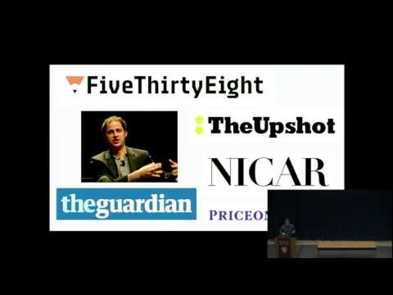

Slide 72
Workshop: generating ideas with data
Stage 1: Generate (news) story ideas from data diaries
Stage 2: Generate (feature) ideas from news stories (follow ups)
Stage 3: Generate (both) story ideas from data

